Slide 1
Period 11- UNIT 2: MY HOME
Lesson 3: A Closer Look 2

Slide 2
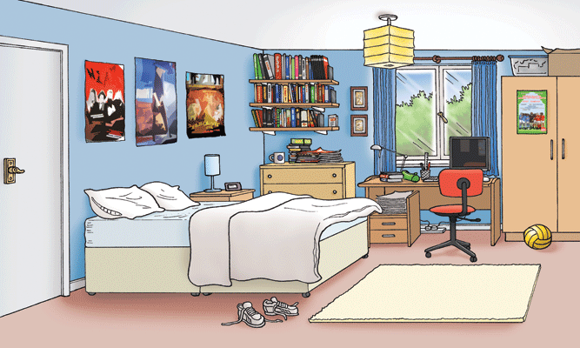

Slide 3
1. Grammar
Singular
Plural
There is +
(+ )
a/ an + Singular noun
There are +
Plural noun
Uncountable noun
(- )
a/ an + Singular noun
There isn’t +
There aren’t +
Plural noun
Uncountable noun
a/ an + Singular noun?
(? )
Is there +
Are there +
Plural noun ?
Uncountable noun?
- Yes, there is.
- Yes, there are.
- No, there isn’t.
- No, there aren’t.
Use: To denote something exists

Slide 4
2. Practice
Exercise 1: Write is or are.
There __________________ a sofa in the living room.
There __________________ two cats in the kitchen.
There __________________ posters on the wall.
There __________________ a ceiling fan in the bedroom.
There __________________ dishes on the floor.
is
are
are
is
are

Slide 5
Exercise 3: Write positive and negative sentences.
Example: pictures / the living room
There are pictures in the living room.
There aren’t pictures in the living room.
a TV/ the table
a brown dog / the kitchen
a boy / the cupboard
a bath / the bathroom
lamps / the bedroom

Slide 6
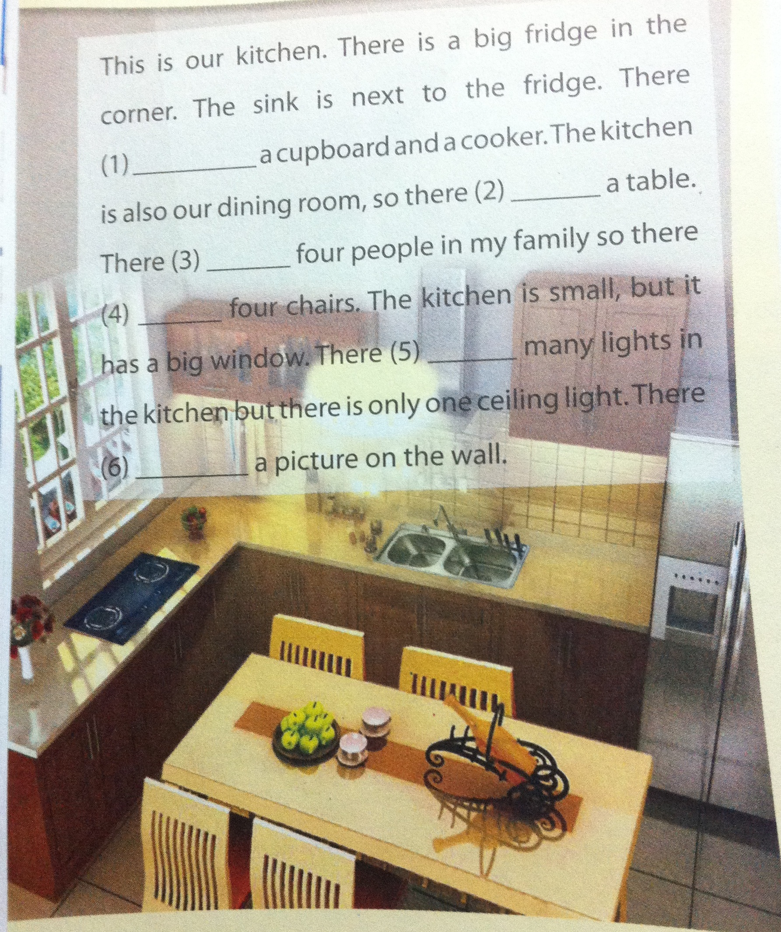
Exercise 4: Write is / isn’t / are / aren’t in each blank to describe the kichen in Mi’s house.
is
is
are
are
aren’t
isn’t

Slide 7
Exercise 5: Complete the questions.
_________________a fridge in your kitchen?
_________________ a TV in your bedroom?
_________________ four chairs in your living room?
_________________a desk next to your bed?
_________________ two sinks in your bathroom?
Is there
Is there
Are there
Is there
Are there

Slide 8
DISCUSSION
Ask and answer
about your own room

Slide 9
HOMEWORK
1. Write sentences part 3.
2. Do Exercise B4- P.11 – Workbook
3. Prepare: Communication

